Slide 1






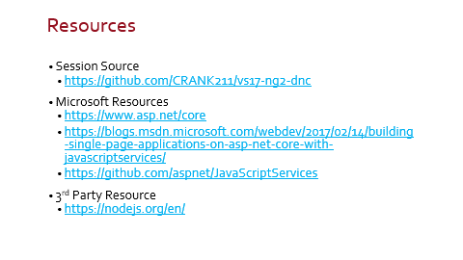


Building Web Apps Powered by Angular 2 using Visual Studio 2017

Slide 2

Building web apps powered by Angular 2 using Visual Studio 2017
Daren May – CRANK211
@darenmay

Slide 3

Who Am I?
Daren May – President & Co-founder of Crank211
Microsoft MVP – Windows Development
CRANK211 Designs and Builds:
Web Applications
UWP Applications
X-Platform Mobile
Interests
Biking, hiking and working out

Slide 4
Agenda
Getting Started
Essential Tools
Create an App
Explore the Sample
Starting Fresh
Setup for your app
Html Mock to Angular
Incorporating Data Services
Deploy to Azure
Wrap Up

Slide 5
Getting started

Slide 6
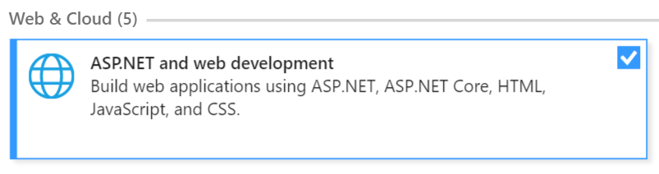
Essential Tools
Visual Studio 2017!
Include:
Node.js version 6 or later

Slide 7
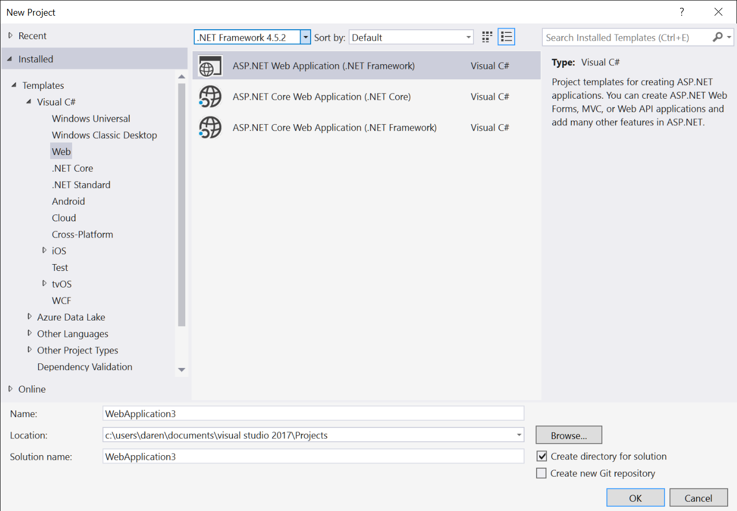
Creating a Project

Slide 8
Installing the SPA Templates
C:\Users\Daren>node --version
v7.5.0
C:\Users\Daren>dotnet new --install Microsoft.AspNetCore.SpaTemplates::*
Restoring packages for C:\Users\Daren\.templateengine\dotnetcli\v1.0.0-rc4-004771\scratch\restore.csproj...
Installing System.Xml.XPath 4.0.1.
Installing runtime.native.System.IO.Compression 4.1.0.
Installing Microsoft.NETCore.DotNetHost 1.0.1.
Installing Microsoft.NETCore.Targets 1.0.1.
Installing System.Xml.XPath.XDocument 4.0.1.
(and many more!!!!)

Slide 9
Creating an App
C:\Users\Daren>mkdir CrankBank
C:\Users\Daren>cd CrankBank
C:\Users\Daren\CrankBank>dotnet new angular
Content generation time: 1426.9369 ms
The template "MVC ASP.NET Core with Angular" created successfully.
C:\Users\Daren\CrankBank>start crank-bank.csproj

Slide 10
demo
Check Tool Versions
Install the Templates
Create An App
Notes:
At the command-line:
node --version
dotnet --version
dotnet new --install Microsoft.AspNetCore.SpaTemplates::*
To actually generate a new project, first create an empty directory for it to go into, cd to that directory, and then use dotnet new to create your project.
At the command-line:
mkdir crankbank
cd crankbank
dotnet new angular

Slide 11
Summary
Identified essential tools
Demonstrated how to install the SPA Templates
See Steve Sanderson blog post:
https://blogs.msdn.microsoft.com/webdev/2017/02/14/building-single-page-applications-on-asp-net-core-with-javascriptservices/
Created a new Angular SPA app using the template and opened it in Visual Studio 2017

Slide 12
Explore the Sample

Slide 13
demo
Explore
Compile
Debug
Notes:
Explore the project in visual studio
Uses WebPack – a module bundler for javascript apps – webpack.config.js - https://webpack.js.org/concepts/
Tsconfig,json – configures the TypeScript transpiler
Package.json – node packages – note test script
Show NPM Task runner - https://marketplace.visualstudio.com/items?itemName=MadsKristensen.NPMTaskRunner
Show npm test output
ASP.NET Core App
Startup.cs - on refresh or manual URL load, index.cshtml would be loaded and load the Angular2 Core that would then manage the wanted route with the router.
Explore the views for index.cshtml
Show HomeController is very simple
We’ll come back to the SampleDataController
Angular App
Edit – GoTo – show the options – app.module
System imports – note angular2/universal adds server side rendering and includes BrowserModule, HttpModule and JsonpModules
App level imports (add a newline)
Discuss the router
Use F12 got to definition to navigate to app.component
Ctrl [,s to sync solution explorer – note the nested related objects – HTML-> CSS, TS
Note the @Component decorator that specifies the path to the related files
Open the html file – note <nav-menu> element and the <router-outlet>
Show NavMenu component and revisit the router
Demonstrate the compilation – note first build takes time due to package restore – nuget, node, etc.
Remark upon the Chrome integration – debugging support etc
Demo debugging – breakpoint in counter-component.ts
Finally, take a look through the FetchData component.
Demo live update of the view and auto update of browser (add a <p>Live change!</p> and add 100 and ‘ Yuck!’ to the two temperature templates)

Slide 14
Summary
Explored app in VS and some of the configuration files
Demonstrated the project can be opened, built and launched from Visual Studio 2017
Demonstrated Chrome and Service debugging
Demonstrated hot updates

Slide 15
Starting fresh

Slide 16
Preparing for our App
Delete the components we don’t need
CounterComponent
FetchDataComponent
NavMenu
Update app.module.ts
Update AppComponent
Update HomeComponent

Slide 17
demo
Delete
Update
Run
Notes:
Delete the following folders:
Counter
Fetchdata
Navmenu
Update app.module.ts
Remove imports and delete components – note the red squigglies indicating the TS language service knows we have a problems
Delete the invalid routes
Update app.component.html
Remove the <nav-menu> element
Extend the div containing the router-outlet by removing the col class
Update the home.component.html
Just leave the <h1>Hello, World</h1> element

Slide 18
Summary
Demonstrated simple cleanup

Slide 19
Html Mock to Angular

Slide 20
Objective
Take some HTML Mocks and create a simple Angular App
Review the HTML and break into components
Implement simple navigation through the App

Slide 21
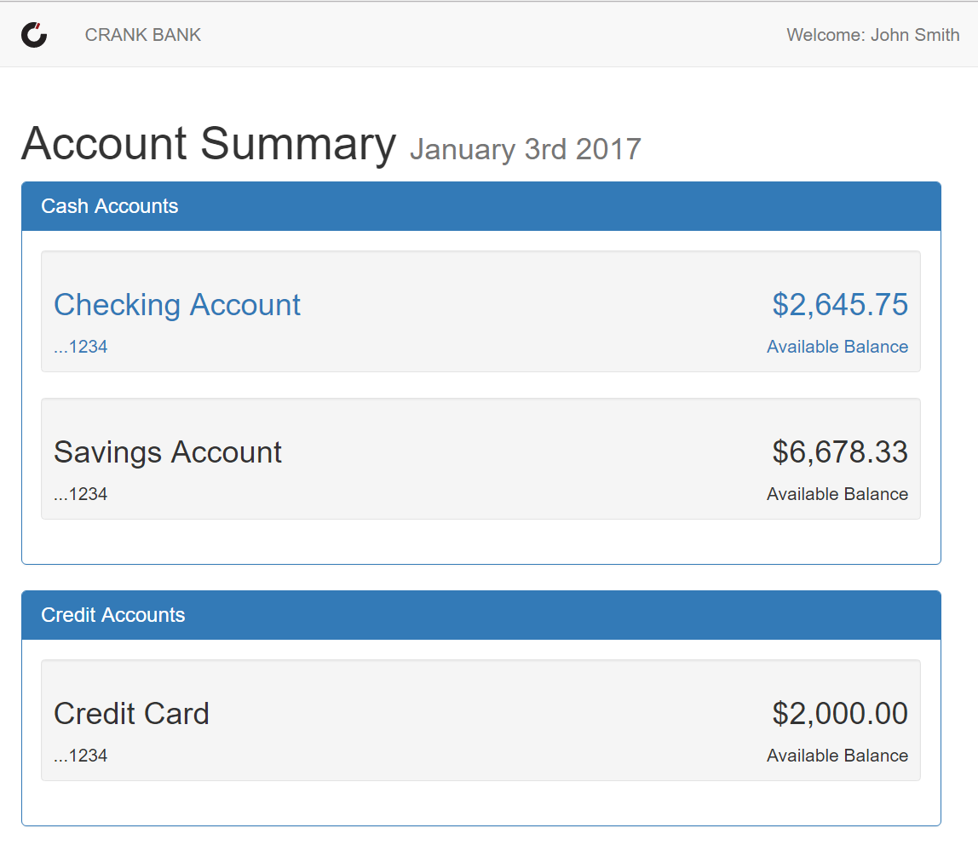
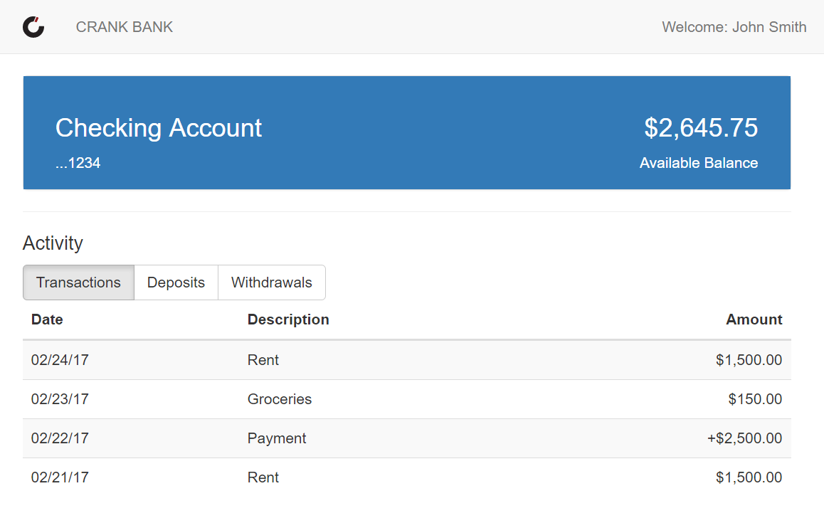
Crank Bank

Slide 22
Account Summary - Breakdown
Shared Header Component
Account Summary List Component
Account Summary Component

Slide 23
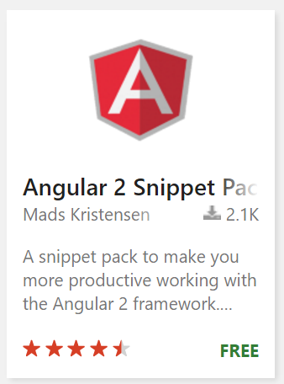
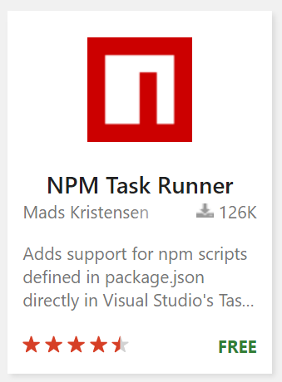
Useful Extensions
Visual Studio Marketplace: Mads Kristensen
Angular 2 Snippet Pack
NPM Task Runner

Slide 24
demo
Create Simple Account Summary Components
Notes:
Create the 3 components
Create Folder for nav header
Create the html, css and ts file – note nesting, note rename support
Open ts file – use ng2-component snippet – note error: ‘angular/core’ instead of ‘@angular/core’
Run through the snippet
Show how to fix the snippet:
C:\Program Files (x86)\Microsoft Visual Studio\2017
SKU
TS
Language – EN-US = 1033
Snippets/Angular 2/ng2.component.snippet
Add to Module

Slide 25
Account Detail - Breakdown
Shared Header Component
Account Detail Component
Account Summary Component
Account Activity Component

Slide 26
demo
Create Account Detail Components
Notes:
Create the 3 components
Create Folder for nav header
Create the html, css and ts file – note nesting, note rename support
Open ts file – use ng2-component snippet – note error: ‘angular/core’ instead of ‘@angular/core’
Run through the snippet
Show how to fix the snippet:
C:\Program Files (x86)\Microsoft Visual Studio\2017
SKU
TS
Language – EN-US = 1033
Snippets/Angular 2/ng2.component.snippet
Add to Module

Slide 27
Recap – app-module
// Import system and app components/modules …
@NgModule({
bootstrap: [AppComponent],
declarations: [AppComponent, HomeComponent, …], // all components
imports:[UniversalModule, // must be first for server side
RouterModule.forRoot([
{ path: '', redirectTo: 'account', pathMatch: 'full' },
{ path: 'account', component: AccountListComponent },
{ path: 'detail/:id', component: AccountDetailComponent}
])
})
export class AppModule { }

Slide 28
Recap – app-component
import { Component } from '@angular/core';
@Component({
selector: 'app',
templateUrl: './app.component.html',
styleUrls: ['./app.component.css']
})
export class AppComponent {
}

Slide 29
Recap – index.cshtml
@{
ViewData["Title"] = "Home Page";
}
<app asp-prerender-module="ClientApp/dist/main-server">
Loading...
</app>
<script src="~/dist/vendor.js" asp-append-version="true"></script>
@section scripts {
<script src="~/dist/main-client.js"
asp-append-version="true"></script>
}

Slide 30
Recap – simple output binding
<div class="well well-sm mouseOver" (click)="navigateToDetails()">
export class AccountSummaryComponent {
constructor(private _router: Router) {
}
navigateToDetails() {
this._router.navigate(['/detail', '1234']);
}
}

Slide 31
Summary
Demonstrated creation of simple components
Created a simple route
Used output binding to respond to a click
Routed through code

Slide 32
Incorporating data

Slide 33
Objective
Create data classes
Remove the hard coded data in the HTML
Display data using binding and templates

Slide 34
demo
Data Binding
Data Services

Slide 35
Recap - binding
Expression binding -
<h3>{{ account.name }}</h3>
<h3>{{ 4 + 4 }}</h3>
Null Guard – {{ account?.name }}
Input binding – [account]="account"
Output binding – (click)="navigateToDetails()"
Two-way binding – [(property)]="account"

Slide 36
Recap - pipes
<h3>{{ account?.balance | currency:'USD':true:'2.2-2' }}</h3>
$2,123.23
<span>{{ account?.accountNumber | formatAccountNumber }}</span>
…1234
import { Pipe, PipeTransform } from '@angular/core';
@Pipe({ name: 'formatAccountNumber' })
export class FormatAccountNumberPipe implements PipeTransform {
transform(value: string): string {
if (!value) return "";
return "..." + (value.length >= 4 ? value.substring(value.length - 4) : value);
}
}

Slide 37
Recap – templates
<div class="panel-body">
<span *ngIf="!cashAccounts">No Cash Accounts
</span>
<account-summary
*ngIf="cashAccounts"
*ngFor="let account of cashAccounts"
[account]="account">
</account-summary>
</div>

Slide 38
Recap – encapsulating data access in services
import { Injectable } from '@angular/core';
import { Http } from '@angular/http';
import { Observable } from 'rxjs/Rx';
import { AccountSummary } from './account-summary.type';
@Injectable()
export class AccountService {
constructor(private http: Http) { }
getAccountSummaries(): Promise<AccountSummary[]> {
return this.http.get('api/Bank/GetAccountSummaries')
.map(response => response.json() as AccountSummary[])
.toPromise();
}
}

Slide 39
Recap – leveraging services
import { Component, OnInit } from '@angular/core';
import { IAccountSummary, AccountType } from '../../shared/AccountSummary';
import { AccountService } from '../../shared/account.service';
@Component({ … })
export class AccountListComponent implements OnInit {
cashAccounts: IAccountSummary[];
creditAccounts: IAccountSummary[];
constructor(private accountService: AccountService) {
}
ngOnInit() {
this.accountService.getAccountSummaries()
.then(
accounts => {
this.cashAccounts = accounts.filter(v => v.type === AccountType.Checking ||
v.type === AccountType.Savings);
this.creditAccounts = accounts.filter(v => v.type === AccountType.Credit);
});
}
}

Slide 40
Recap – app-module
// Import system and app components/modules …
@NgModule({
bootstrap: [AppComponent],
declarations: [AppComponent, AccountListComponent],
imports: [UniversalModule, // must be first for server side
RouterModule.forRoot([
{ path: '', redirectTo: 'home', pathMatch: 'full' },
{ path: 'home', component: ALComp },
{ path: 'detail/:id', component: AccountDetailComponent }]),
providers: [AccountService ] // dependency injection
})
export class AppModule { }

Slide 41
Recap – ASP.NET WebApi Controller
[Route("api/[controller]")]
public class BankController : Controller
{
private static AccountSummary[] _accountSummaries =
new AccountSummary[]
{ new AccountSummary{ // static data } };
[HttpGet("[action]")]
public IActionResult GetAccountSummaries()
{
return new ObjectResult(_accountSummaries);
}
}

Slide 42
Summary
Demonstrated bindings
Created a custom pipe component
Showed how to use structural directives (*ngIf, *ngFor) to build templates
Created a service component and used DI
Leverage http to call a WepApi

Slide 43
Deploying to azure

Slide 44
Deployment Options
DevOps and Continous Integration (CI) builds
Publish direct from Visual Studio 2017

Slide 45
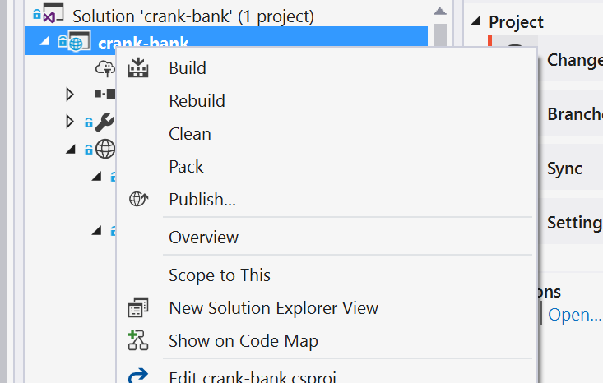
Publish to Azure

Slide 46
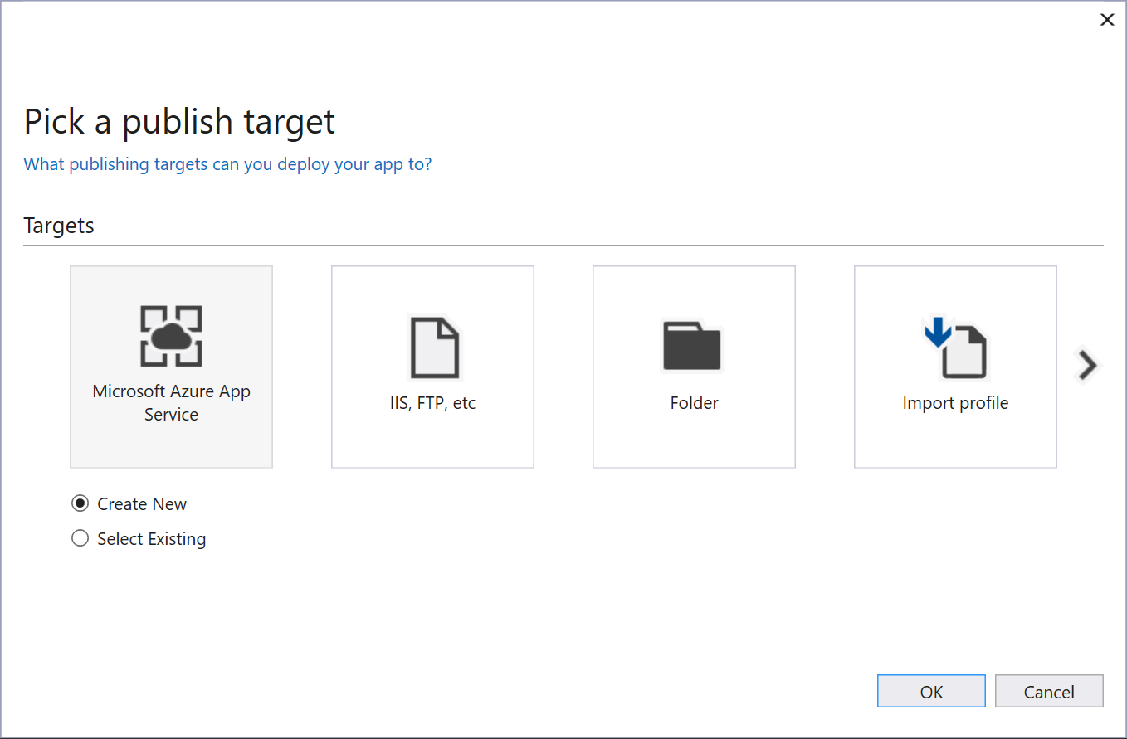
Create Publishing Profile and Chose a target

Slide 47
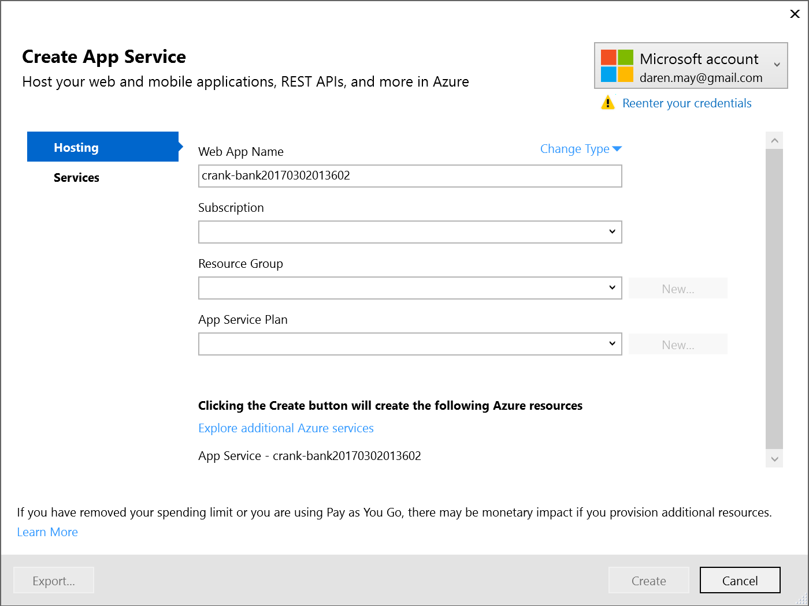
Sign in… and choose options on Azure

Slide 48
Sign in… and choose options on Azure

Slide 49
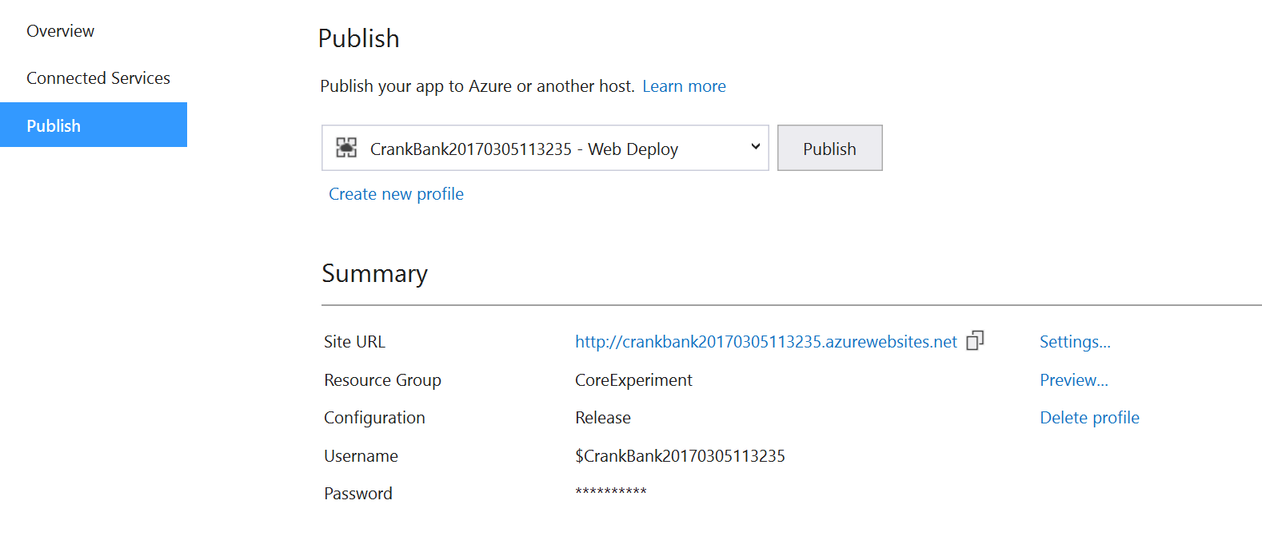
Publish

Slide 50
demo
Deploy
Notes:
Delete the following folders:
Counter
Fetchdata
Navmenu
Update app.module.ts
Remove imports and delete components – note the red squigglies indicating the TS language service knows we have a problems
Delete the invalid routes
Update app.component.html
Remove the <nav-menu> element
Extend the div containing the router-outlet by removing the col class
Update the home.component.html
Just leave the <h1>Hello, World</h1> element

Slide 51
Summary
Demonstrated simple publish to Azure

Slide 52
Wrap up

Slide 53
Agenda
Getting Started
Essential Tools
Create an App
Explore the Sample
Starting Fresh
Setup for your app
Html Mock to Angular
Incorporating Data Services
Deploy to Azure
Wrap Up

Slide 54
Resources
Session Source
https://github.com/CRANK211/vs17-ng2-dnc
Microsoft Resources
https://www.asp.net/core
https://blogs.msdn.microsoft.com/webdev/2017/02/14/building-single-page-applications-on-asp-net-core-with-javascriptservices/
https://github.com/aspnet/JavaScriptServices
3rd Party Resource
https://nodejs.org/en/

